Slide 1

Launching new EC2 & VPC from Visual Studio Code using Python
Ankita Phadke
03/16/23

Slide 2
Using Visual Studio Code to create new EC2/VPC
Option 1:
Install Python & pip on Windows (if not already done)
Install boto3
Run new Python script from Visual Studio Code & spin off new EC2, create new VPC
Option 2:
Python & pip need NOT be installed on Windows
Open new Jupyter Notebook inside Visual Studio Code
Pip install boto3 inside Visual Studio Code/AWS boto3 extension
Run the Python script from Visual Studio Code & spin off new EC2, create new VPC

Slide 3
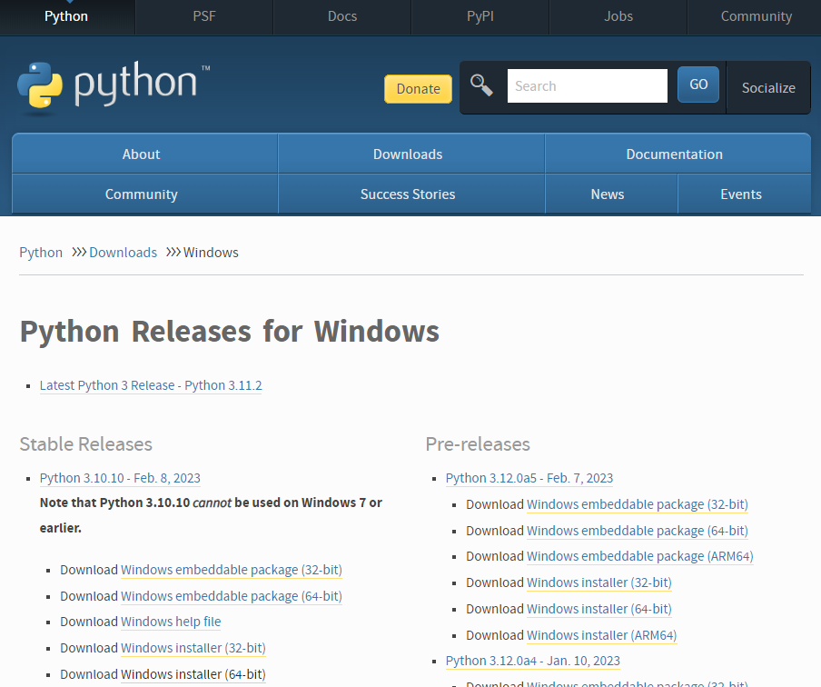
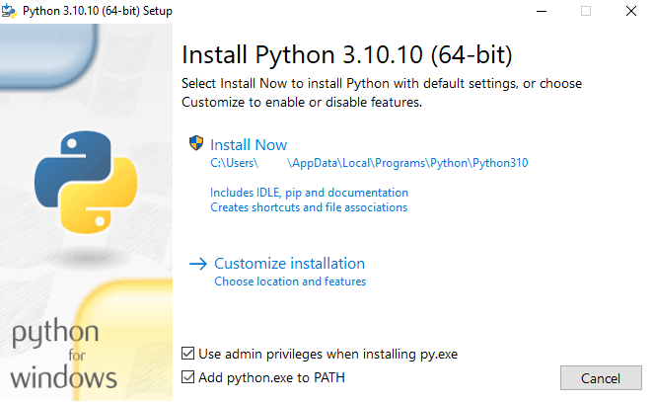
Option 1: Downloading & installing Python in PC
URL:https://www.python.org/downloads/
- This is needed to be done if Python is not installed in Windows
- This step is required to run pip install commands, to install the
library boto3, to be used for AWS
2. Run the installer
1. Select the correct Windows installer

Slide 4
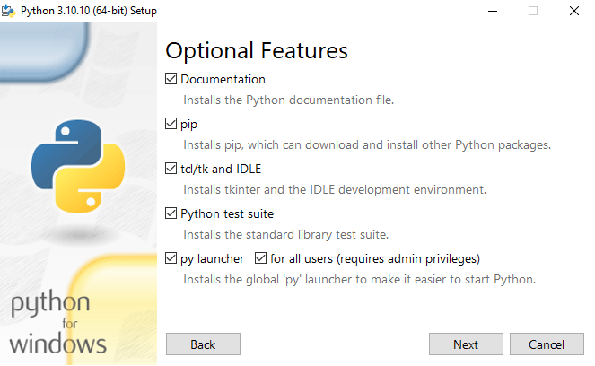
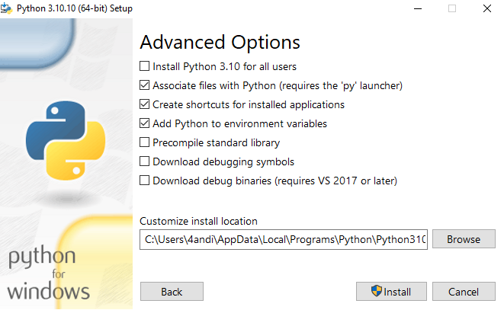
Downloading & installing Python in PC
3. Select optional features
4. Select Advanced options

Slide 5
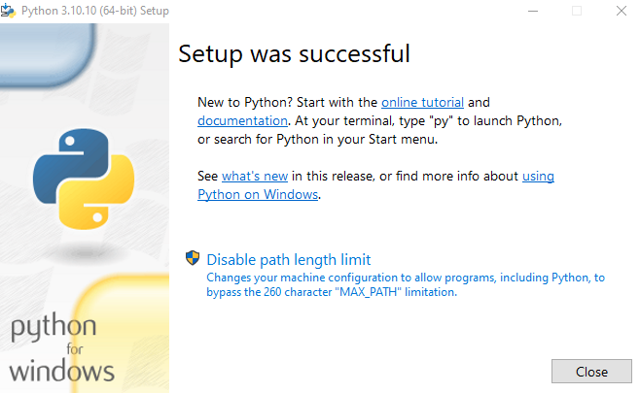
Downloading & installing Python in PC
Verify if Python is successfully installed:
Run the below command on the command line:
Python --version
If installed correctly, the output shows latest
Installed Python version:
Python 3.10.10
5. Complete the setup

Slide 6
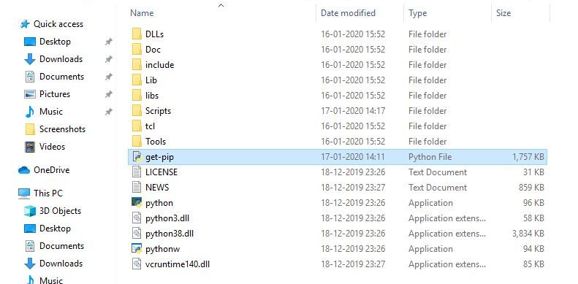
Install pip on Windows
PIP is a package management system used to install and manage software packages/libraries written in Python.
Reference: https://www.geeksforgeeks.org/how-to-install-pip-on-windows/
Python must be installed on Windows (pre-requisite)
2. Navigate to the path where get-pip is stored & run the below command:
python get-pip.py
1: Download the get-pip.py (https://bootstrap.pypa.io/get-pip.py) file and store it in the same directory as python is installed.

Slide 7
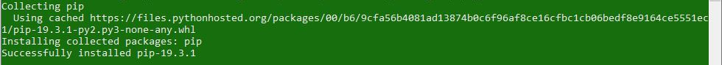
Install boto3 on Windows
3. After running the command, pip is installed, and above confirmation is received
4. To confirm that pip is correctly installed, below command can be run
pip -V or pip --version
5. Once the above step is completed, we can install boto3 on windows
pip install boto3

Slide 8
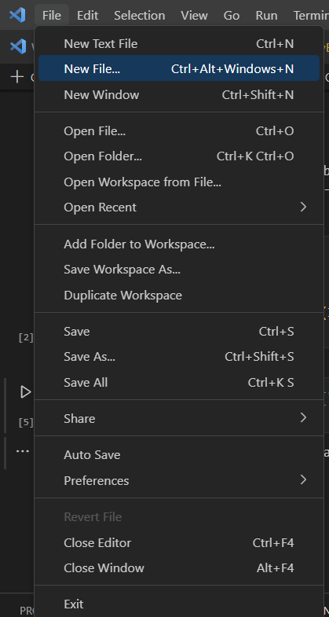
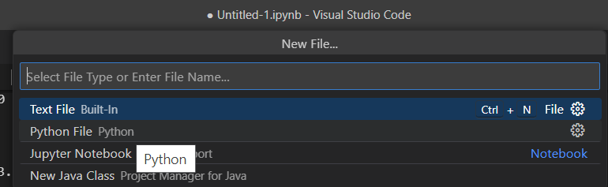
Using Visual Studio Code to create new EC2
Option 2) Using Python
Open File -> New File
Select Python

Slide 9
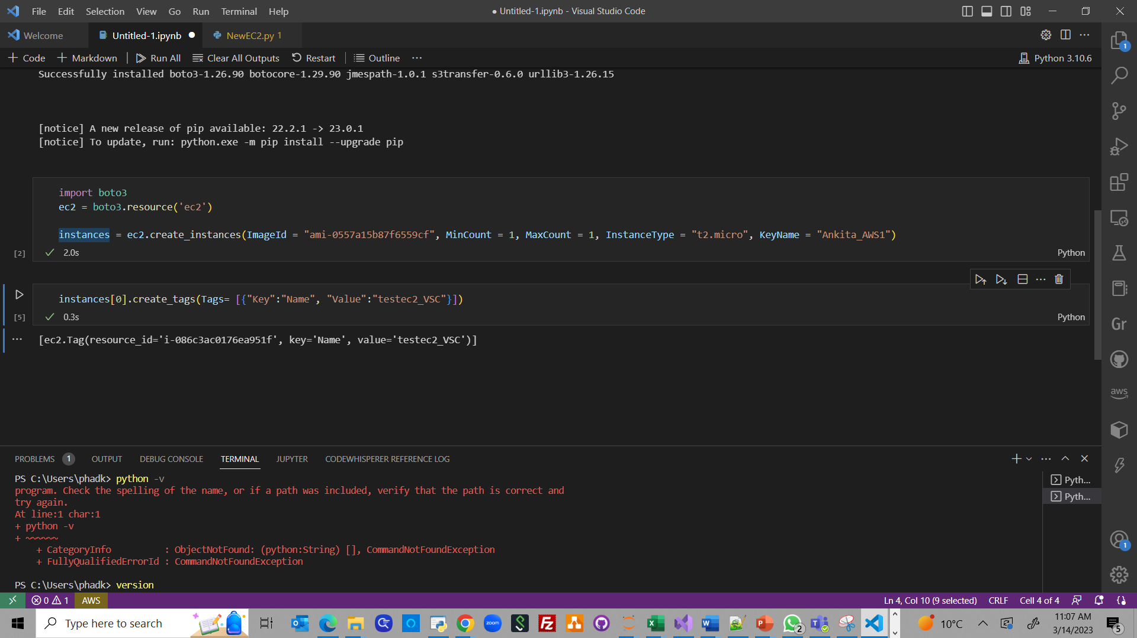
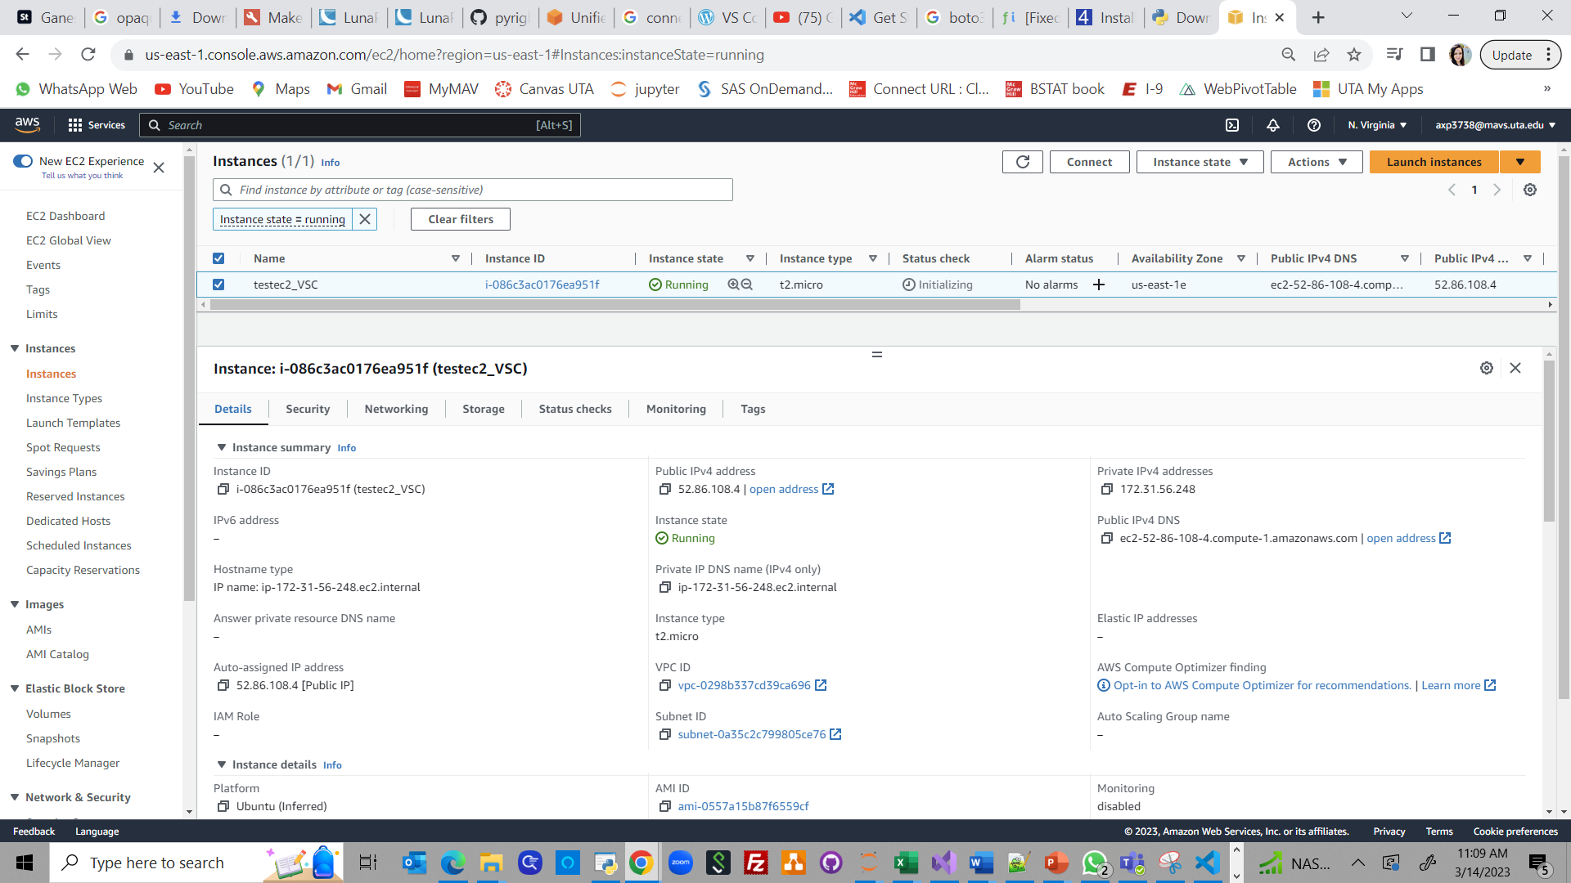
Using Visual Studio Code to create new EC2
Run the below Python script & new EC2 is created

Slide 10
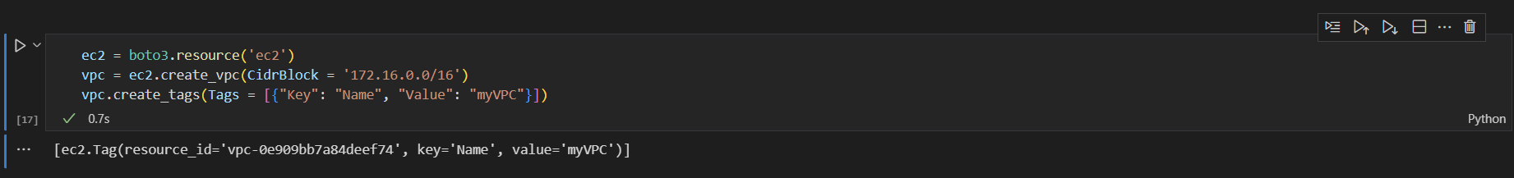
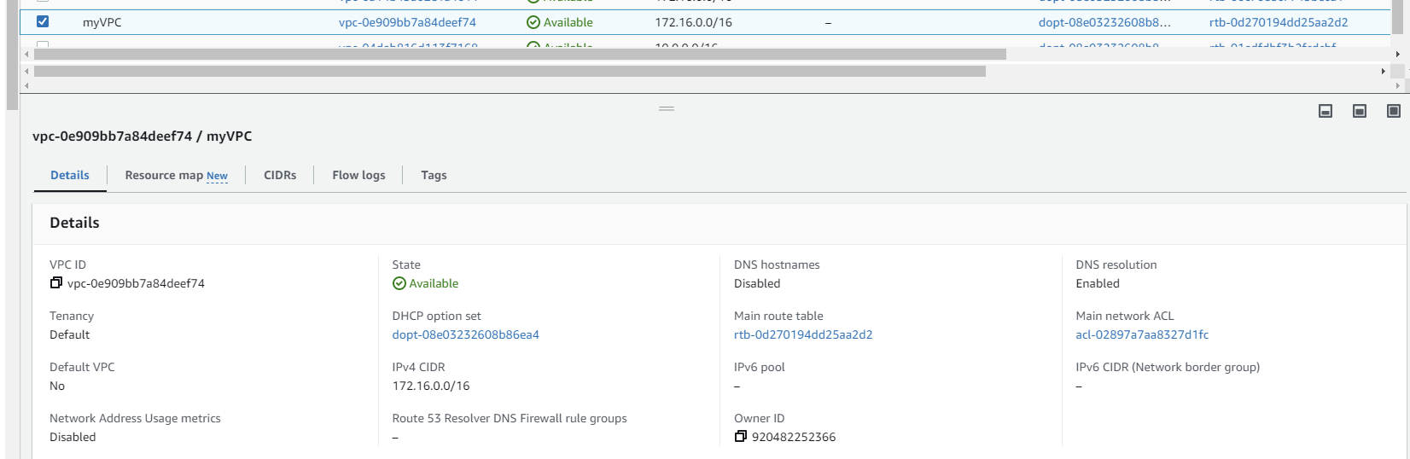
Using Visual Studio Code to create new VPC
Run the below Python script, to create new VPC & name as ‘myVPC’. New VPC is created and can be seen in AWS.

Slide 11
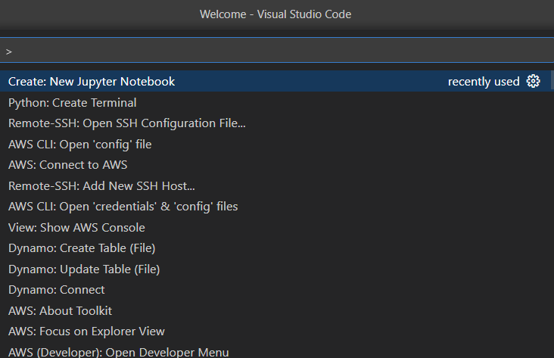
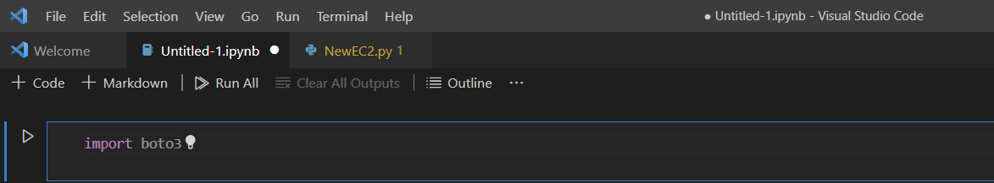
Option 2: Using Jupyter Notebook inside VSC
Open View > Command Palette> Create New Jupyter Notebook inside Visual Studio Code,
type code in .ipynb file to install boto3

Slide 12
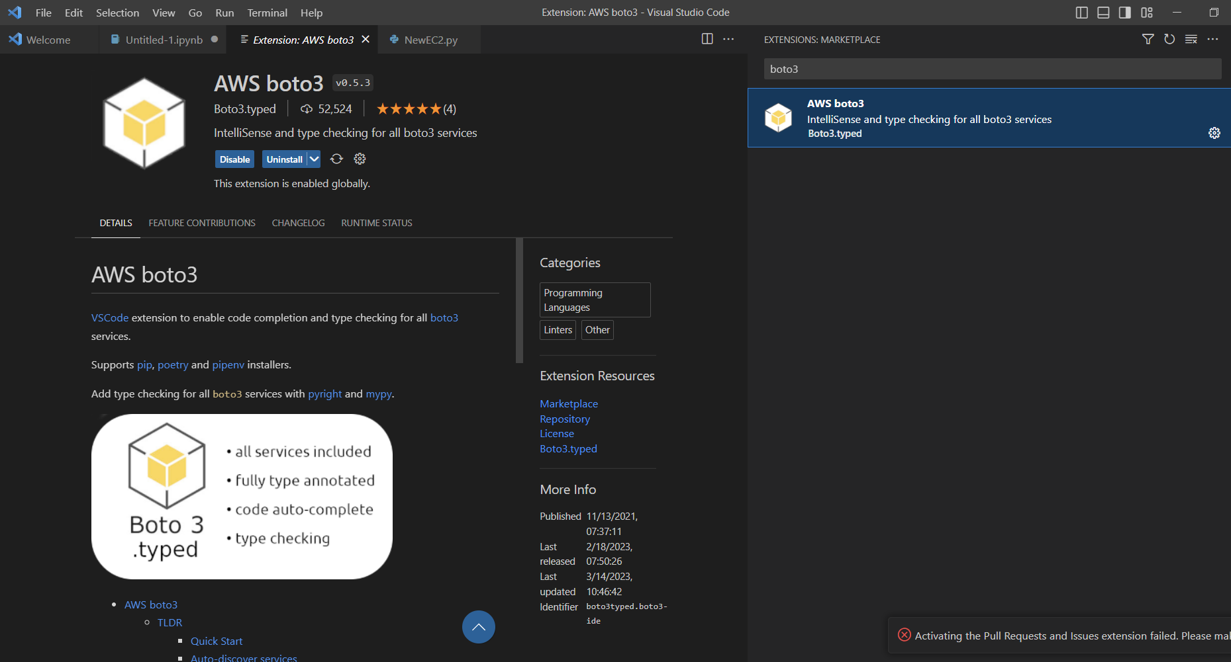
Or we can use AWS boto3 extension inside VSC

Slide 13
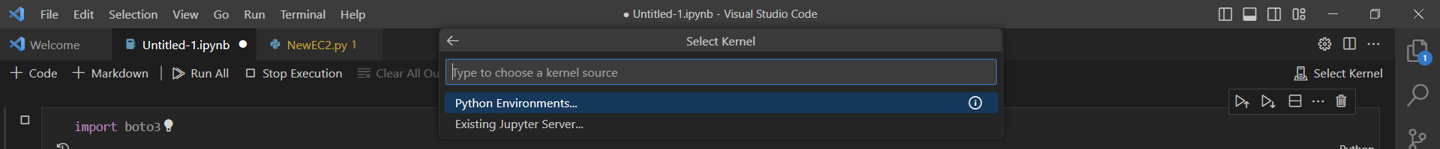
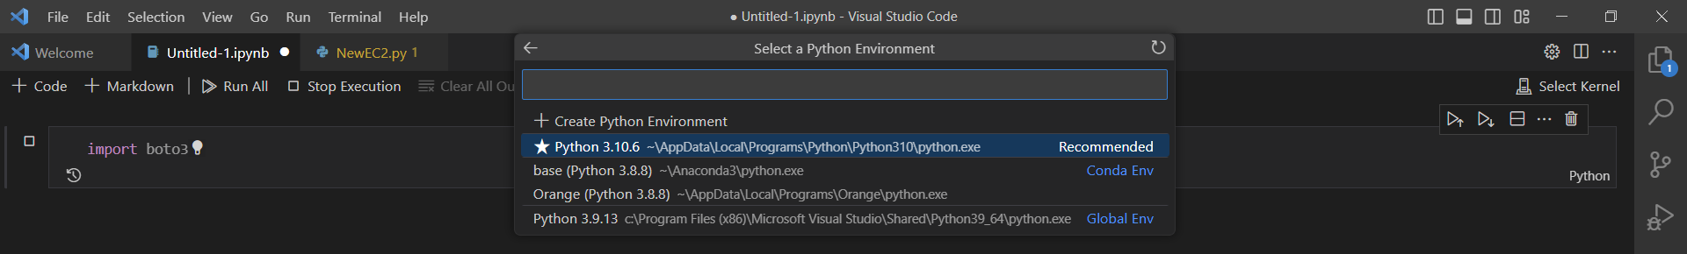
Using Jupyter Notebook inside VSC to create EC2
Select Kernel and Python environment

Slide 14
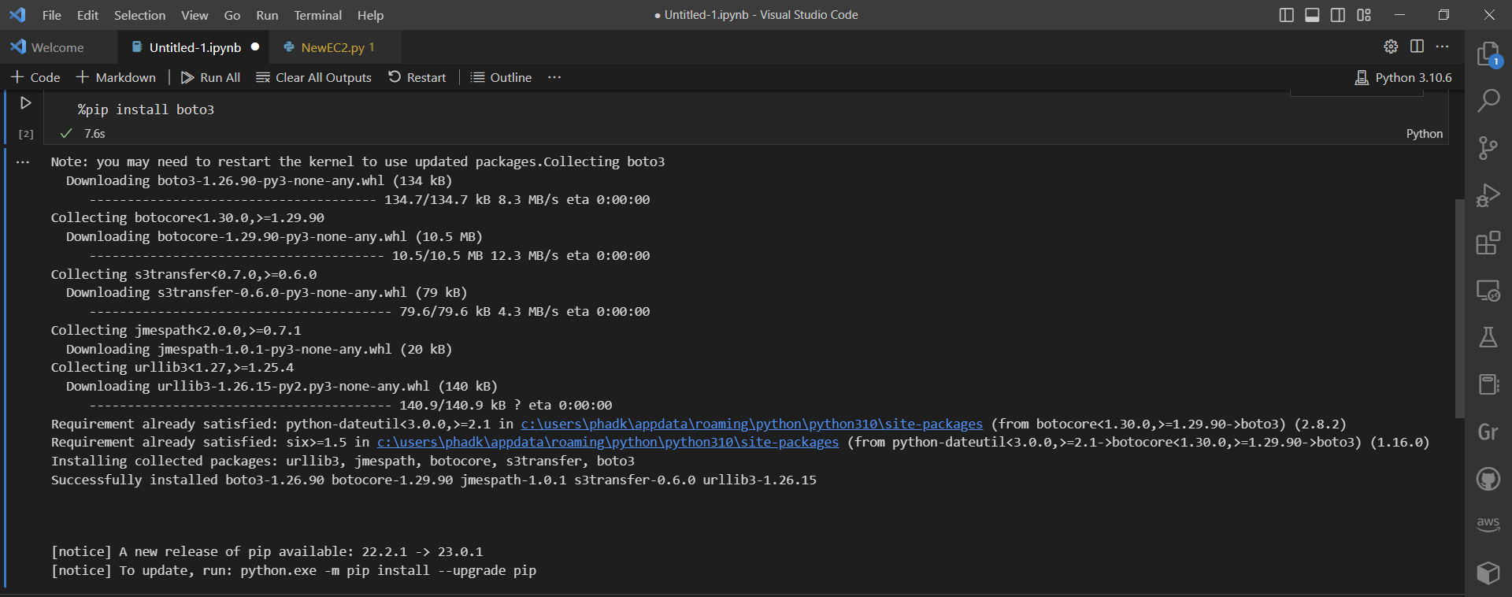
Using Jupyter Notebook inside VSC to create EC2
Boto3 is installed on VSC

Slide 15
Using Jupyter Notebook inside VSC to create EC2
Restart VSC & run the code to create new EC2. New EC2 can be seen running inside AWS

Slide 16
Using Jupyter Notebook inside VSC to create VPC
Run the below Python script, to create new VPC & name as ‘myVPC’. New VPC is created and can be seen inside AWS.

Slide 17
References:
https://4sysops.com/archives/install-boto3-aws-sdk-for-python-in-visual-studio-code-vs-code-on-windows/
https://blog.finxter.com/fixed-modulenotfounderror-no-module-named-boto3/
https://code.visualstudio.com/docs/python/python-tutorial
https://www.youtube.com/watch?v=vblRmAr_CLU

